Slide 2
Antra SEP Program
Hello World
Core Java Training 3

Slide 3
Day 3 Training Schedule
Object-Oriented Programming (OOP) concepts
Inheritance
Encapsulation
Polymorphism
Accessibility
Abstract Class and Interface
Type Casting

Slide 4
Object-Oriented Programming(OOP)
Data Hiding
Abstraction
Encapsulation
IS-A Relationship
HAS-A Relationship
Overloading
Overriding
Constructors
Coupling
Cohesion
Object Type Casting

Slide 5
Data Hiding
Our internal data should not go out directly that is outside person can’t access our internal data directly.
By using private modifier we can implement data hiding.
Example:
class Account {
private double balance;
}

Slide 6
Abstraction
Hide internal implementation and just highlight the set of services, is called abstraction.
By using abstract classes and interfaces we can implement abstraction.

Slide 7
Is-a relationship & Has-a relationship
Is-a relationship is known as inheritance.
The main advantage of IS-A relationship is reusability.
Has-a relationship is composition/aggregation
class Engine {
//engine specific functionality
}
class Car{
Engine e=new Engine();
//........................;
}

Slide 8
Composition
Without existing container object if there is no chance of existing contained objects then the relationship between container object and contained object is called composition which is a strong association.
Example:
University consists of several departments whenever university object destroys automatically all the department objects will be destroyed that is without existing university object there is no chance of existing dependent object hence these are strongly associated and this relationship is called composition.

Slide 9
Aggregation
Without existing container object if there is a chance of existing contained objects such type of relationship is called aggregation. In aggregation objects have weak association.
Example:
Within a department there may be a chance of several professors will work whenever we are closing department still there may be a chance of existing professor object without existing department object the relationship between department and professor is called aggregation where the objects having weak association.

Slide 10
Overloading
class Test{
public void methodOne(){
System.out.println("no-arg method");
}
public void methodOne(int i){
System.out.println("int-arg method");
}
public void methodOne(double d){
System.out.println("double-arg method");
}
public static void main(String[] args){
Test t=new Test();
t.methodOne();//no-arg method
t.methodOne(10);//int-arg method
t.methodOne(10.5);//double-arg method
}
}
Notes:
In overloading compiler is responsible to perform method resolution(decision) based on the reference type. Hence overloading is also considered as compile time polymorphism(or) static

Slide 11
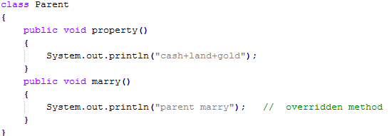
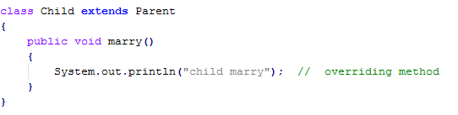
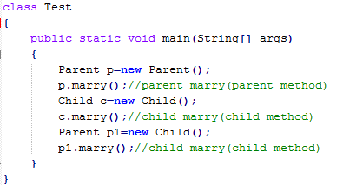
Overriding

Slide 12
Overriding
Parent class final methods we can’t override in the Child class.
Parent class non final methods we can override as final in child class. We can override native methods in the child classes.
We should override Parent class abstract methods in Child classes to provide implementation
We can override Parent class non abstract method as abstract to stop availability of Parent class method implementation to the Child classes.

Slide 13
Coupling
The degree of dependency between the components is called coupling.
Tightly coupling is not a good programming practice because it has several serious disadvantages.
Without effecting remaining components we can't modify any component hence enhancement(development) will become difficult.
It reduces maintainability of the application.
It doesn't promote reusability of the code.
It is always recommended to maintain loosely coupling between the components.

Slide 14
Cohesion
For every component we have to maintain a clear well defined functionality such type of component is said to be follow high cohesion
High cohesion is always good programming practice because it has several advantages.
Without effecting remaining components we can modify any component hence enhancement will become very easy.
It improves maintainability of the application.
It promotes reusability of the application.
Note: It is highly recommended to follow loosely coupling and high cohesion

Slide 15
Typecasting - Implicit casting
Parent class reference can be used to hold Child class object but by using that reference we can’t call Child specific methods.
Example:
Object o=new String("bhaskar");//valid
System.out.println(o.hashCode());//valid
System.out.println(o.length());//C.E:cannot find symbol,symbol : method length(),location: class java.lang.Object
Similarly we can use interface reference to hold implemented class object.
Example:
Runnable r=new Thread();

Slide 16
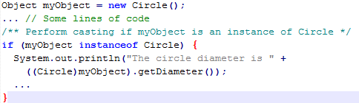
Typecasting - Explicit casting
Explicit casting must be used when casting an object from a superclass to a subclass. This type of casting may NOT always succeed.
  Apple x = (Apple)fruit;
  Orange x = (Orange)fruit;
  if fruit = new Apple(); then first one is correct.
  Use instanceof operator to test whether an object is an instance of a class:

Slide 17
TIP
To help understand casting, you may also consider the analogy of fruit, apple, and orange with the Fruit class as the superclass for Apple and Orange. An apple is a fruit, so you can always safely assign an instance of Apple to a variable for Fruit. However, a fruit is not necessarily an apple, so you have to use explicit casting to assign an instance of Fruit to a variable of Apple.

Slide 18
Polymorphism
An object of a subtype can be used wherever its supertype value is required. This feature is known as polymorphism.
When the method m(Object x) is executed, the argument x's toString method is invoked. x may be an instance of GraduateStudent, Student, Person, or Object. Classes GraduateStudent, Student, Person, and Object have their own implementation of the toString method. Which implementation is used will be determined dynamically by the Java Virtual Machine at runtime. This capability is known as dynamic binding.
public class PolymorphismDemo {
public static void main(String[] args) {
m(new GraduateStudent());
m(new Student());
m(new Person());
m(new Object());
}
public static void m(Object x) {
System.out.println(x.toString());
}
}
class GraduateStudent extends Student {
}
class Student extends Person {
public String toString() {
return "Student";
}
}
class Person extends Object {
public String toString() {
return "Person";
}
}

Slide 19
Dynamic Binding
Dynamic binding works as follows: Suppose an object o is an instance of classes C1, C2, ..., Cn-1, and Cn, where C1 is a subclass of C2, C2 is a subclass of C3, ..., and Cn-1 is a subclass of Cn. That is, Cn is the most general class, and C1 is the most specific class. In Java, Cn is the Object class. If o invokes a method p, the JVM searches the implementation for the method p in C1, C2, ..., Cn-1 and Cn, in this order, until it is found. Once an implementation is found, the search stops and the first-found implementation is invoked.

Slide 20
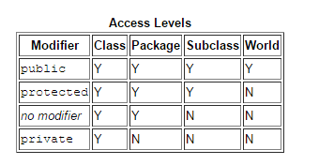
Accessibility Summary

Slide 21
Visibility Modifiers

Slide 22
The final Modifier
The final class cannot be extended:
final class Math {
...
}
The final variable is a constant:
final static double PI = 3.14159;
The final method cannot be overridden by its subclasses.

Slide 23
Abstract Class
Abstract classes in Java are classes which cannot be instantiated, meaning you cannot create new instances of an abstract class. The purpose of an abstract class is to function as a base for subclasses.
Abtract method is a method just have method defination without implementation.
it may or may not include abstract methods.
If a class includes abstract methods, then the class itself must be declared abstract
public abstract class GraphicObject {
// declare fields
// declare nonabstract methods
abstract void draw(); //abstract method is optional
}

Slide 24
Abstract Class

Slide 25
Abtract Class
An abstract method cannot be contained in a nonabstract class. If a subclass of an abstract superclass does not implement all the abstract methods, the subclass must be defined abstract. In other words, in a nonabstract subclass extended from an abstract class, all the abstract methods must be implemented, even if they are not used in the subclass.
You cannot create an instance from an abstract class using the new operator, but an abstract class can be used as a data type.
GeometricObject[] geo = new GeometricObject[10];

Slide 26
Interfaces
An interface is a classlike construct that contains only constants and abstract methods.
In many ways, an interface is similar to an abstract class, but the intent of an interface is to specify behavior for objects. For example, you can specify that the objects are comparable, edible, cloneable using appropriate interfaces.
Default every method is public abstract.
Default every fiels is public final static.

Slide 27
Define an Interface
public interface InterfaceName {
constant declarations;
method signatures;
}
public interface Edible {
/** Describe how to eat */
public abstract String howToEat();
}

Slide 28
Interface is a Special Class
Each interface is compiled into a separate bytecode file, just like a regular class.
Like an abstract class, you cannot create an instance from an interface using the new operator, but in most cases you can use an interface more or less the same way you use an abstract class. For example, you can use an interface as a data type for a variable, as the result of casting, and so on.
Java doesn't allow multiple inheritence. One class cannot extends multiple classes.
One class can implements multiple interfaces.

Slide 29
Example of interface and Abstract class

Slide 30
Interfaces vs. Abstract Classes
 | Variables | Constructors | Methods
Abstract class | No restrictions | Constructors are invoked by subclasses through constructor chaining. An abstract class cannot be instantiated using the new operator. | No restrictions.
Interface | All variables must be public static final | No constructors. An interface cannot be instantiated using the new operator. | All methods must be public abstract instance methods

Slide 31

Thanks!

